Slide 1

S-122 conversion
from IUCN data to S-122 dataset
NIPWG6 - Rostock, Germany (28 January - 1 February 2019)
Notes:
I’d like to give you an overview of the S-122 conversion from IUCN data to S-122 dataset

Slide 2
Background
In late 2018 the product specification went successfully through the Member State approval process and was finally approved as an active standard.
Germany offered at NIPWG5 to test a “best practice” process to produce an S-122 product and to provide the results to NIPWG6.
Notes:
Last year the product specification was finally approved as an active standard and Germany offered at NIPWG5 to test a “best practice”.

Slide 3
Discussion
2 options:
reuse S-57 data
use data provided by IUCN (International Union for Conservation of Nature and Natural Resources).
Notes:
Two options to generate an S-122 product have been considered.
The reuse of S-57 restricted area in the available BSH HPD
and the second option was to use data provided by International Union for Conservation of Nature and Natural Resources.
The RESARE data model doesn’t provide enough elements to extract the needed MPA elements.
The second option, the use of IUCN data, has been considered as the better option.
This based on two assumptions:
the IUCN provides protected areas covering the whole world
the responsible German administrations provided their MPA information to IUCN.

Slide 4
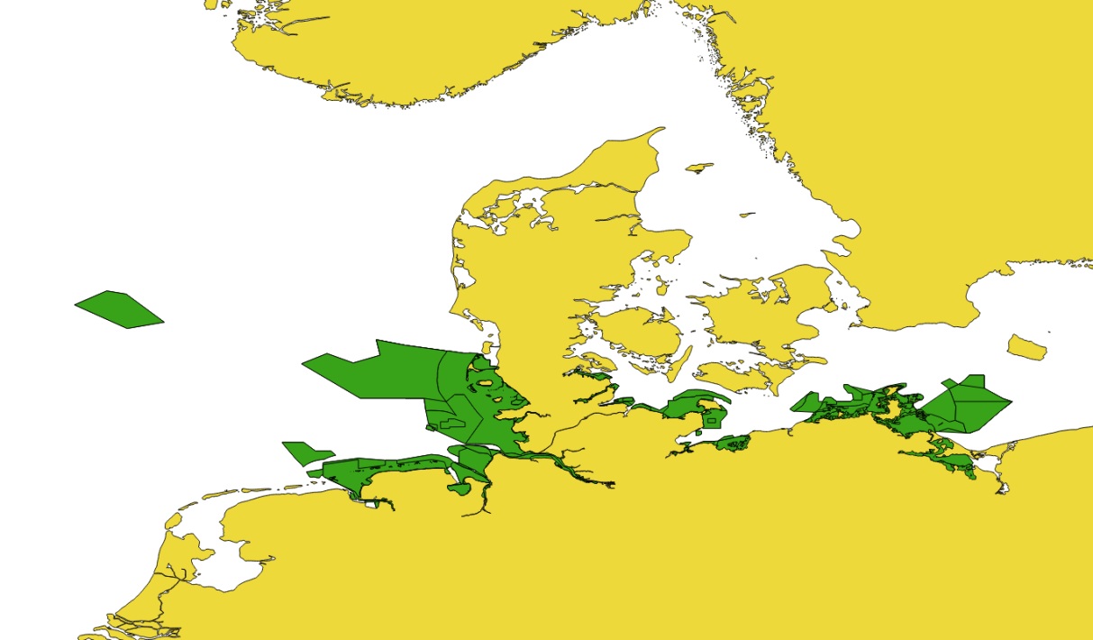
Acquisition and Filtering of the data
https://protectedplanet.net
Notes:
It was intended to develop a semi-automatic process to limit future work on the MPA product updating.
The Marine Protected Areas dataset from IUCN has been selected, downloaded and filtered with SQL statements by different attributes in QGIS

Slide 5

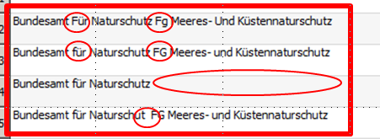
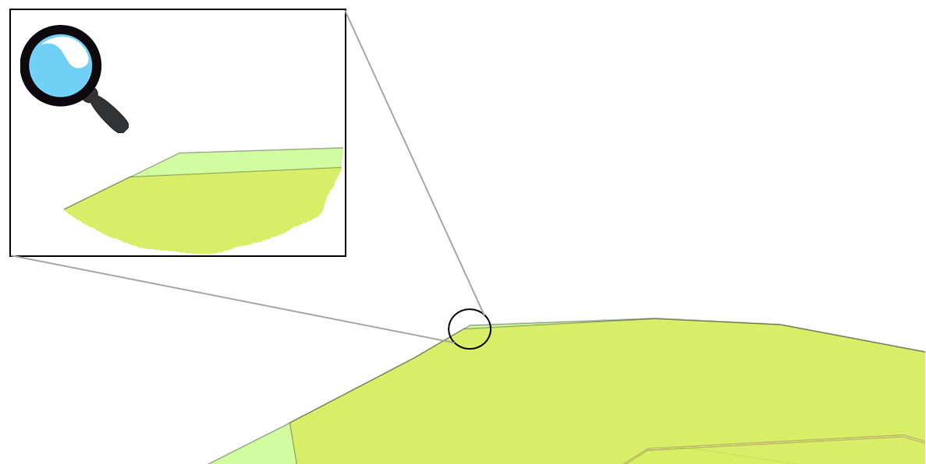
Enhancement of the quality of data
1
2
3
Cleaning and adding data
Notes:
In certain places it was necessary to edit the data manually and semi-automatic (different spelling of same data content).
Figure 1: Data error (wrong authority)
Figure 2: Data error (different spelling)
Figure 3: Discrepancies in geometry
These discrepancies have to be investigated and cleaned at a later time as they were no subject of this study.

Slide 6
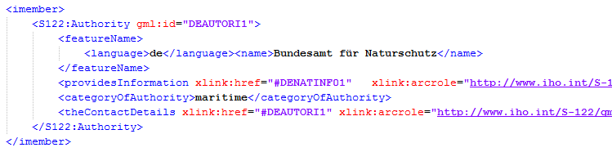
Generating S-122 parts
GML
Areas
GML
Authorities
XSLT
S-122
GML
Regulations
Notes:
Python has been used to join and group the data in S-122 product parts as a native GML export.
XSLT has been used to transform the single GML parts into an S-122 GML product (Figure 7).
XSLT-processors were XMLSpy or ApacheFOP (to hold on open source).
Perspective
BSH is investigating a possible QGIS plugin solution the S-122 product directly without any additional manual actions.

Slide 7

Thank you!
Questions?
Notes:
Thank you! Qustions
You are invited to:
Note the paper.
Invite HOs to generate products based on the provided “Best practice”.
Add the data production tests into the NIPWG work plan.

